Slide 1
To those who will give this presentation
The purpose of this presentation is to provide an overview of the Group Guideline for Safety First
The aim is not to give indepth insight into established methods and ways of working. New slides in this presentation are somewhat more detailed, but the aim is still to give an overview of Safety First.
The presentation material contains information and exercises in reflection.
The Group Guideline is included in the final section of the presentation as additional background material to help you, as a presenter; it is not intended for presentation, but it can be used to give further insight into a particular section of the Group Guideline.
Reserve about 3-4 hours for presentation and exercises for a group of about 20 people, including a coffee break.
Exercises in reflection can be selected based on the group's needs and time.
If you have any questions or concerns prior to your presentation, you are most welcome to contact us at safety.first@lkab.com

Slide 2
Safety First –
It starts with you!
An occasion for talking about Safety First together and what it means for us at LKAB today.

Slide 3
Säkerheten först!
Escape route
Follow signs/take the stairs
Fire extinguisher
Meeting point

Slide 4
Safety First
Common objectives for Safety First
  Strategic objectives for Safety First
  A safe and sound work environment
Work environment Index – meaning, dialogue and reflection
  Safety
  Health
  Inclusion
  Well-being
The Golden Rules
  The six Golden Rules
  It starts with me – exercise
  Introduction of the Golden Rules throughout the entire group
Important components of Safety First
  The basis for LKAB’s work environment management
  Laws and governance
  Risk management
  Suppliers and contractors
  Sanction system for the safety of all
Conclusion
  Summing up the day
Content

Slide 5
Safety First!
1

Slide 6
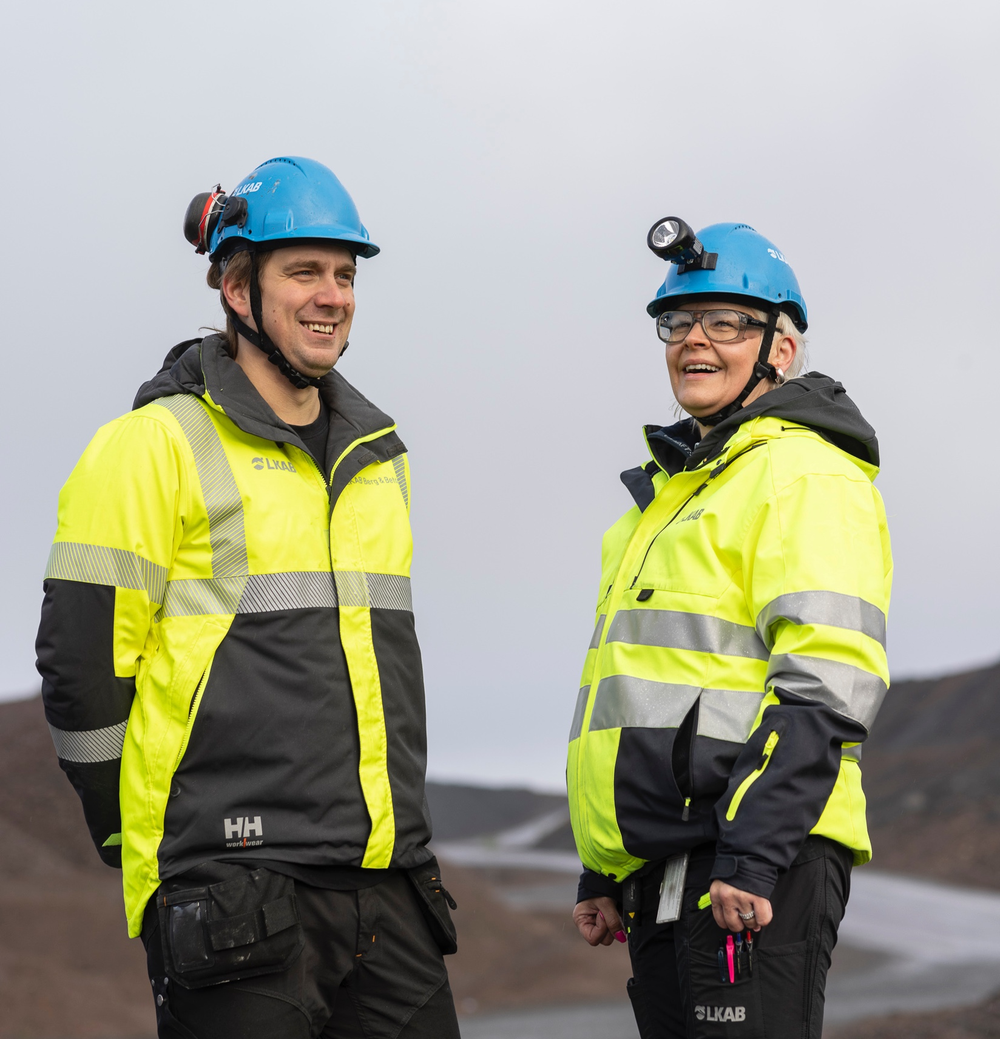
Safety First today
We want to take the next step and significantly reduce the number of accidents.
It is a challenge that will require us to work together and make use of the available knowledge and research. Safety is influenced by various factors, where the technical aspect is rarely the only one. This insight has meant that Safety First has adopted a broader perspective in which factors such as health, inclusion and well-being are included. There are now objectives for all of these aspects.

Slide 7
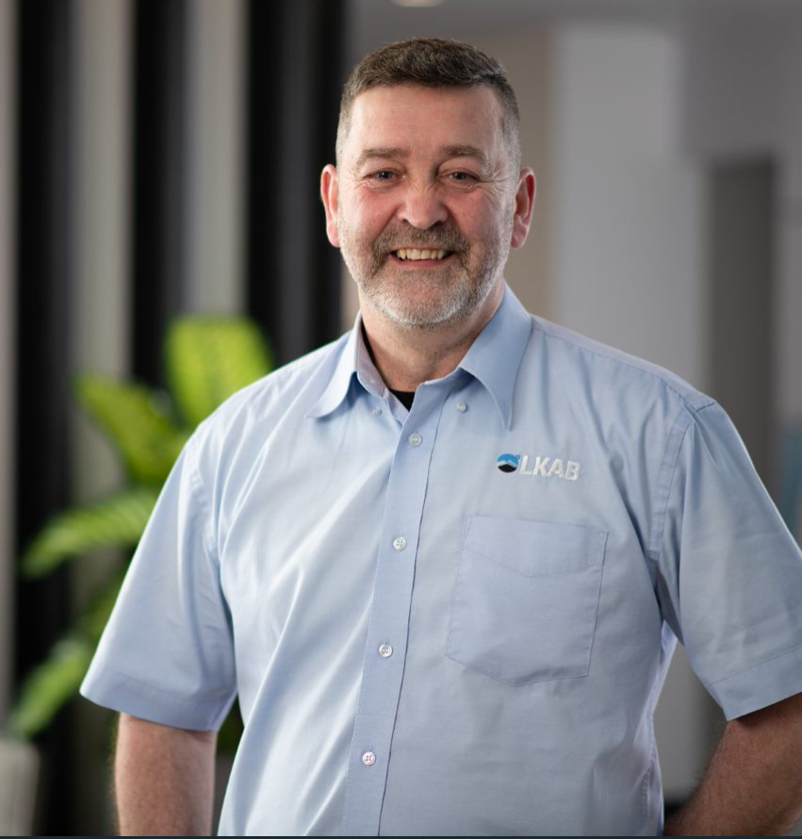
Safety First today
Safety First! Does it mean you’re wearing the correct PPE? Or is it the usual question every summer: 'Can I wear a T-shirt when I'm working in production?’
Many of your colleagues can thank their safety equipment for the fact that their injury wasn't worse, and their safety glasses for the fact that they can still see. Appropriate safety equipment is now a clear part of Safety First.

Slide 8
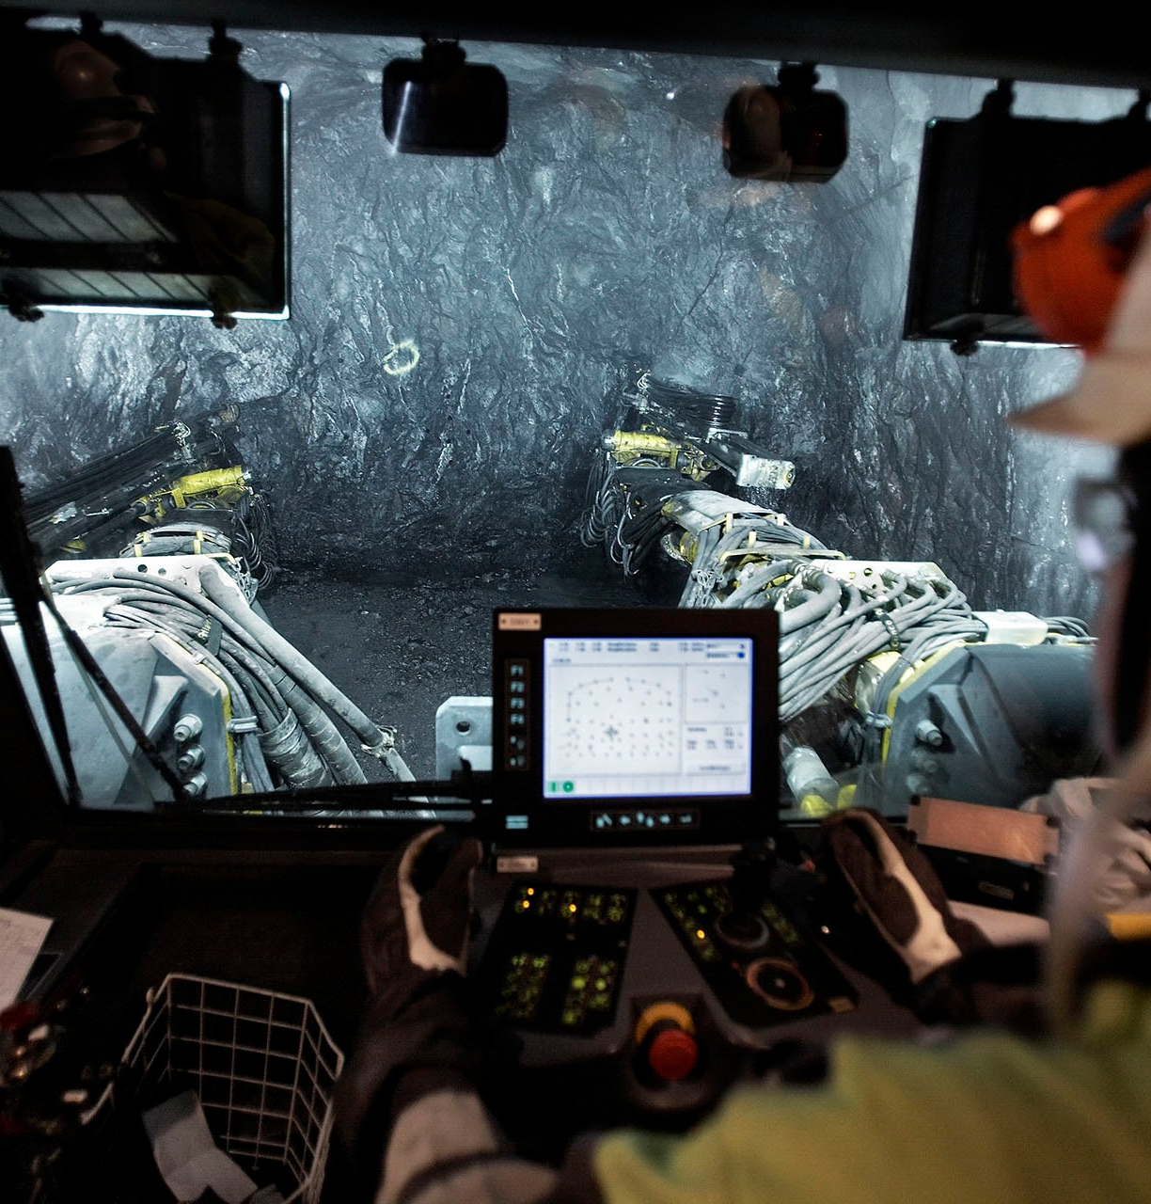
Safety First today
We have come a long way. Regardless of where you work in LKAB, most accidents are due to slipping or use of tools. You may think it's just a matter of accepting this.
LKAB does not.

Slide 9
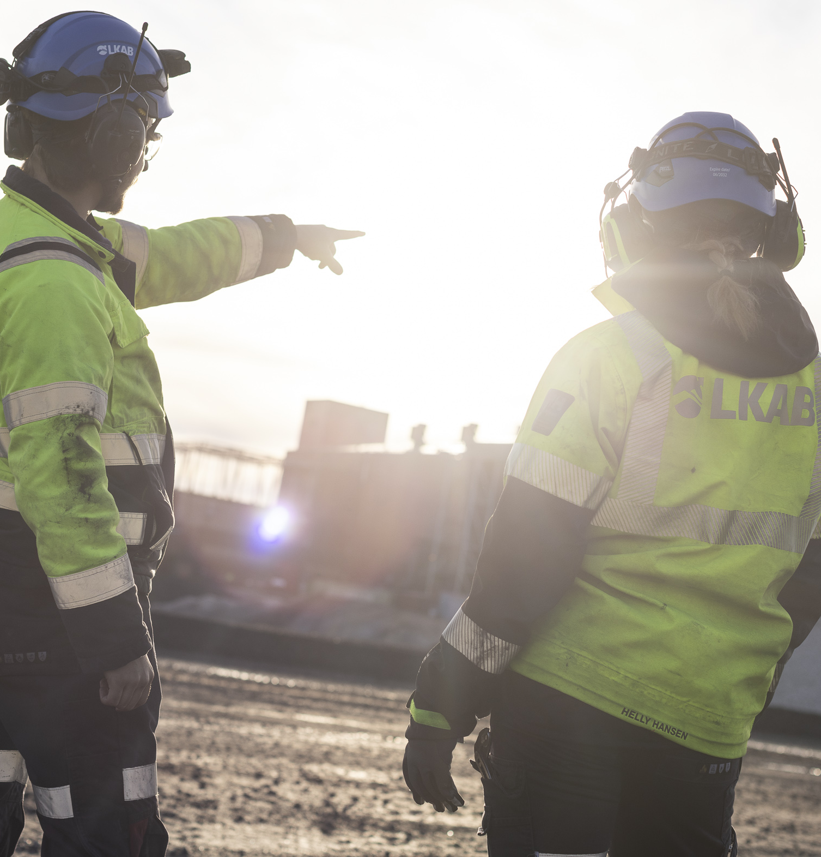
Safety First - then, now and in the future
LKAB has placed safety first since 1943 and called it Safety First since 2006.
What did we mean then, what do we mean now and what do you want this to mean in the future?
Today, we are working to ensure safe work environments in which we are safe and secure, feel at ease and feel well.
We wish to take this opportunity to share our view of what Safety First means for all of LKAB today and at the same time give you the chance to consider how you can help to take Safety First into the future.
It starts with you!

Slide 10
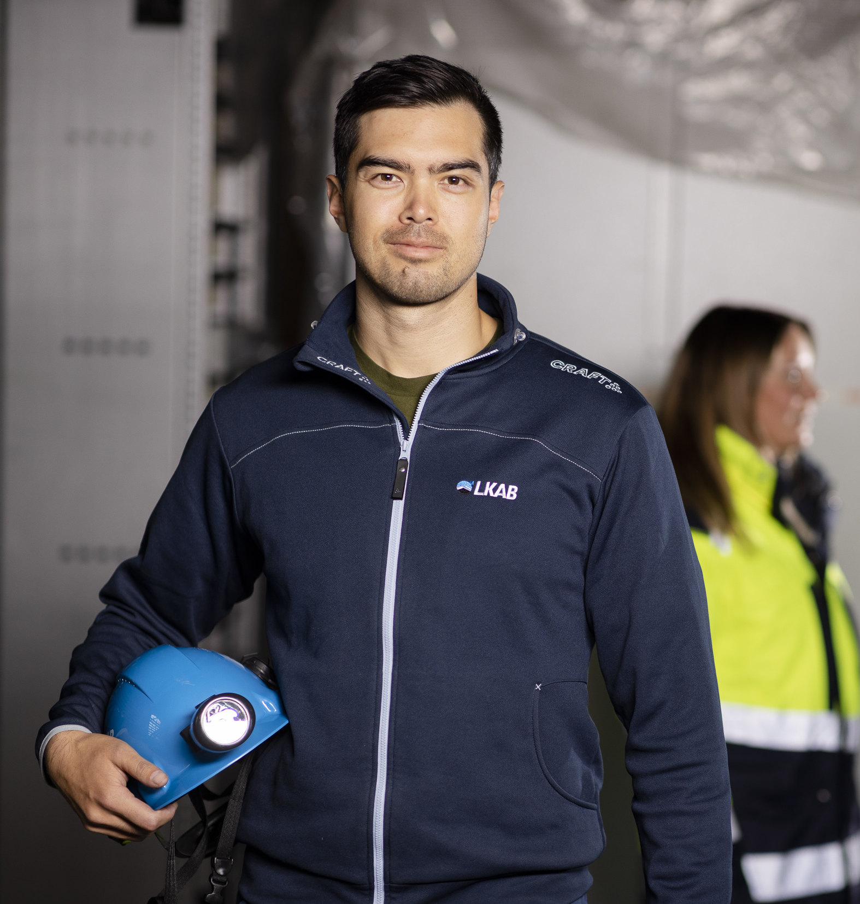
The result of Safety First
For us at LKAB, ensuring a safe and secure work environment that promotes the health and well-being of all who work within our operations is fundamentally important.
Everyone who works for us has the right to go to work knowing they are working in an environment that is safe and sound. At the same time, each of us has an obligation to take responsibility for work environment management.
We wish to lead the change, because safe and sound workplaces are a prerequisite for remaining an attractive employer and business partner.

Slide 11
What does Safety First mean for all of LKAB?
NEW GROUP GUIDELINES:
The Golden Rules: Our behaviour creates safe and healthy workplaces.
SAM/SWE: joint group checklist for systematic work environment management
Common objectives within four sub-areas:
  Safety
  Health
  Well-being
  Inclusion
In 2022 a group guideline for Safety First, applicable for all of LKAB, was established. Most of the guideline is not new and has been in place since at least 2006.
What you see on the right is new for the entire group, but have been used successfully by Special Products for several years.

Slide 12
Common objectives for Safety First
2

Slide 13
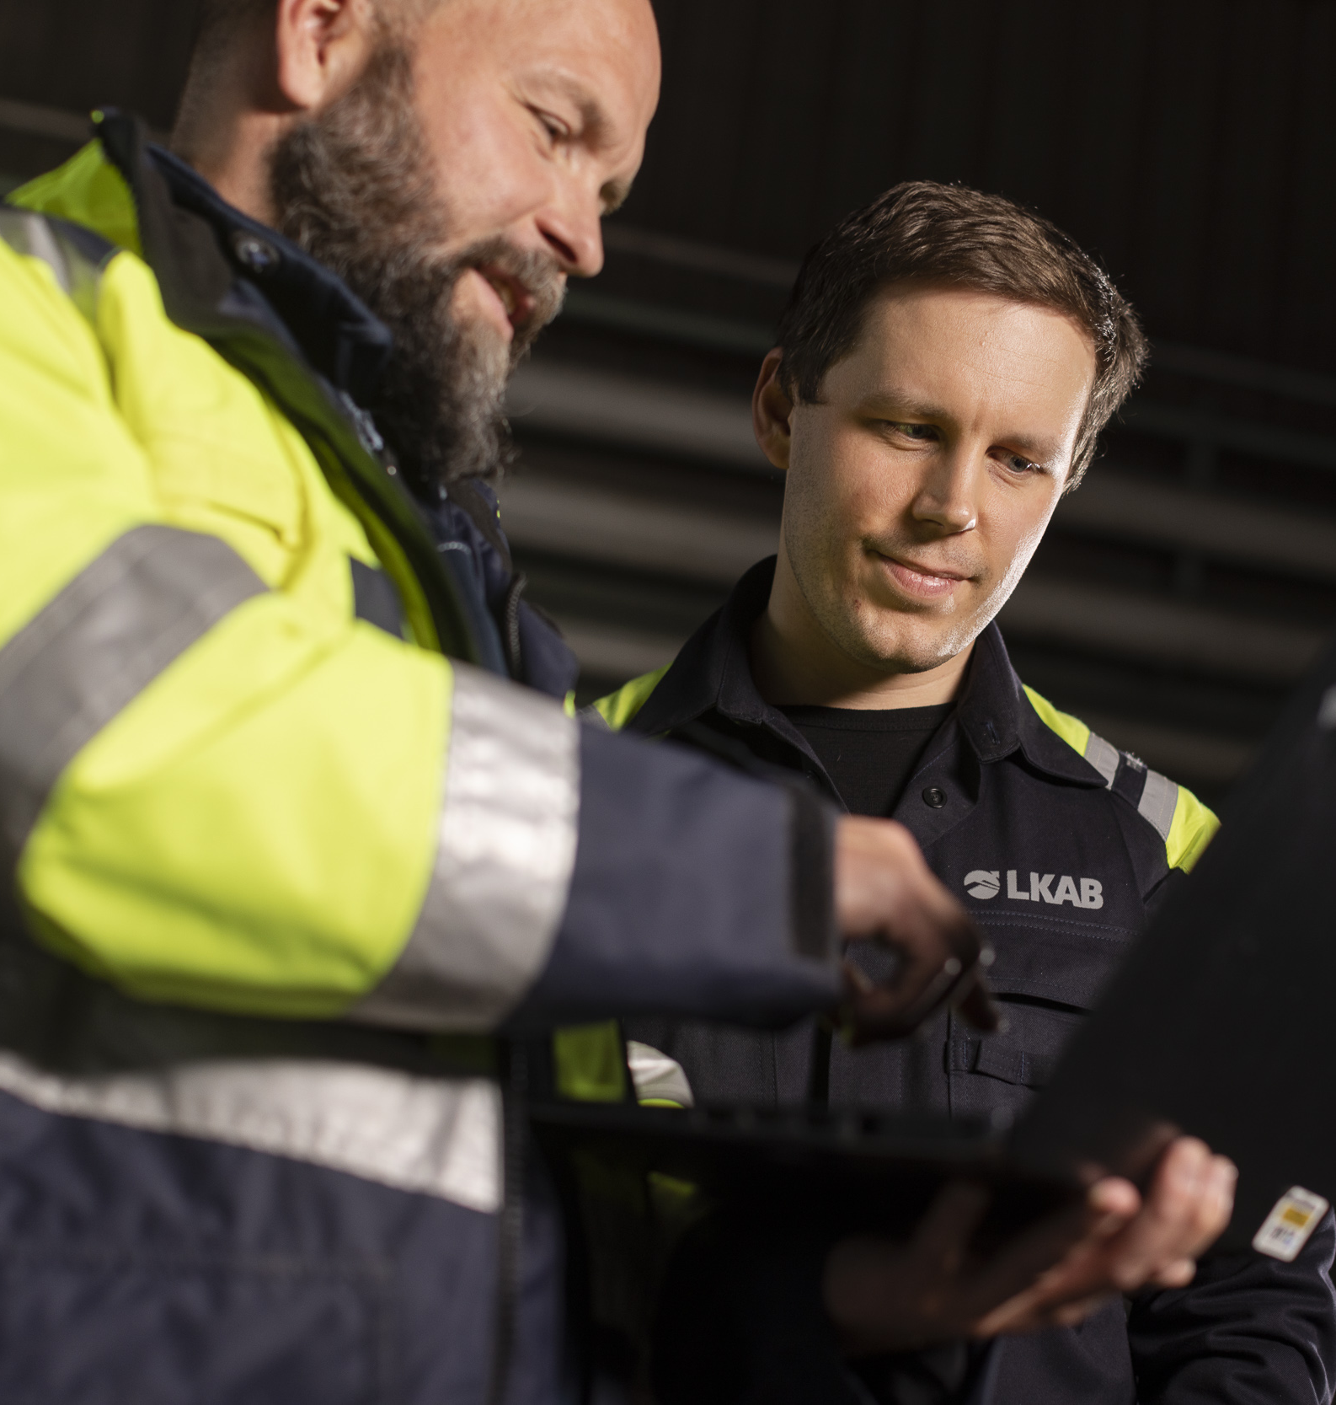
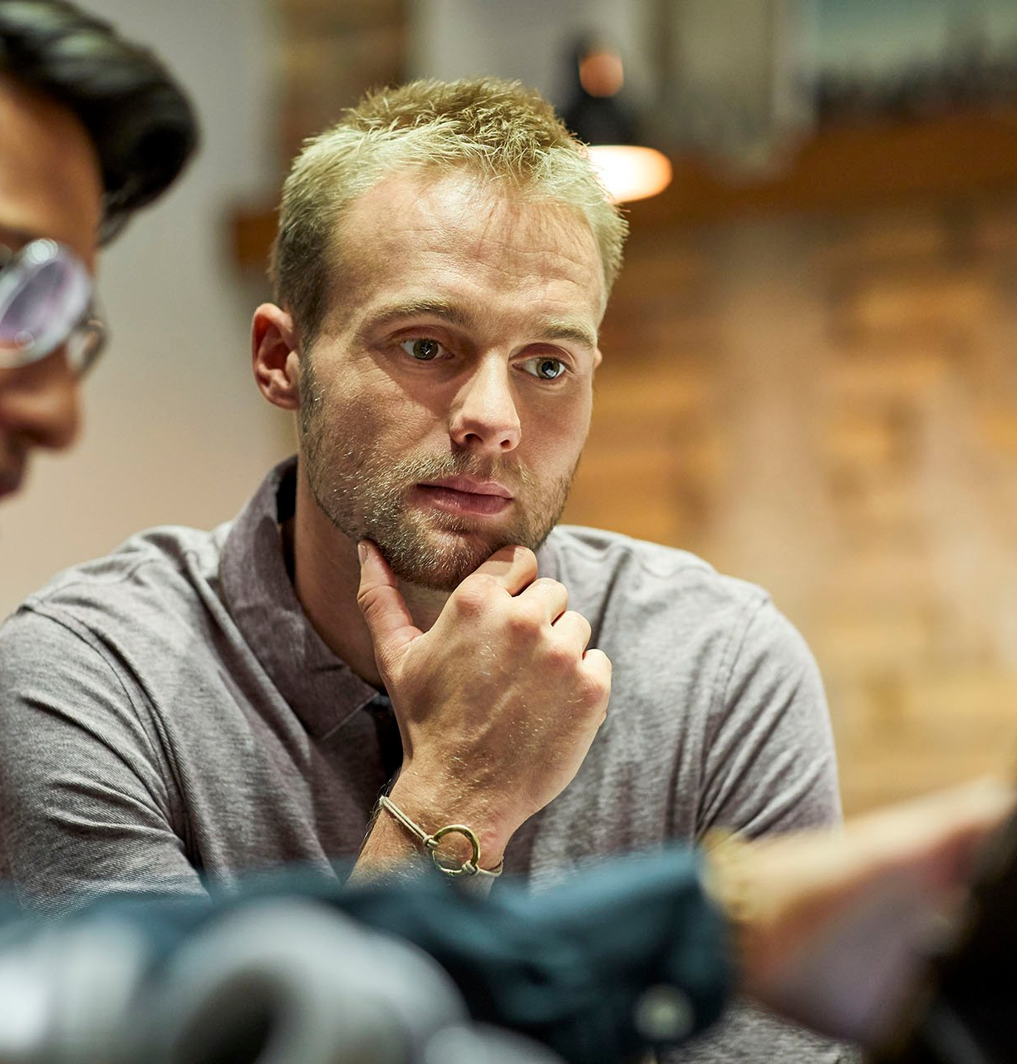
Strategic objectives for Safety First
We set ambitious, measurable and time-limited targets. We use key terms for both preventative and follow-up measures to assess and continuously develop occupational health and safety work together with our collaborative partners and other stakeholders.

Slide 14
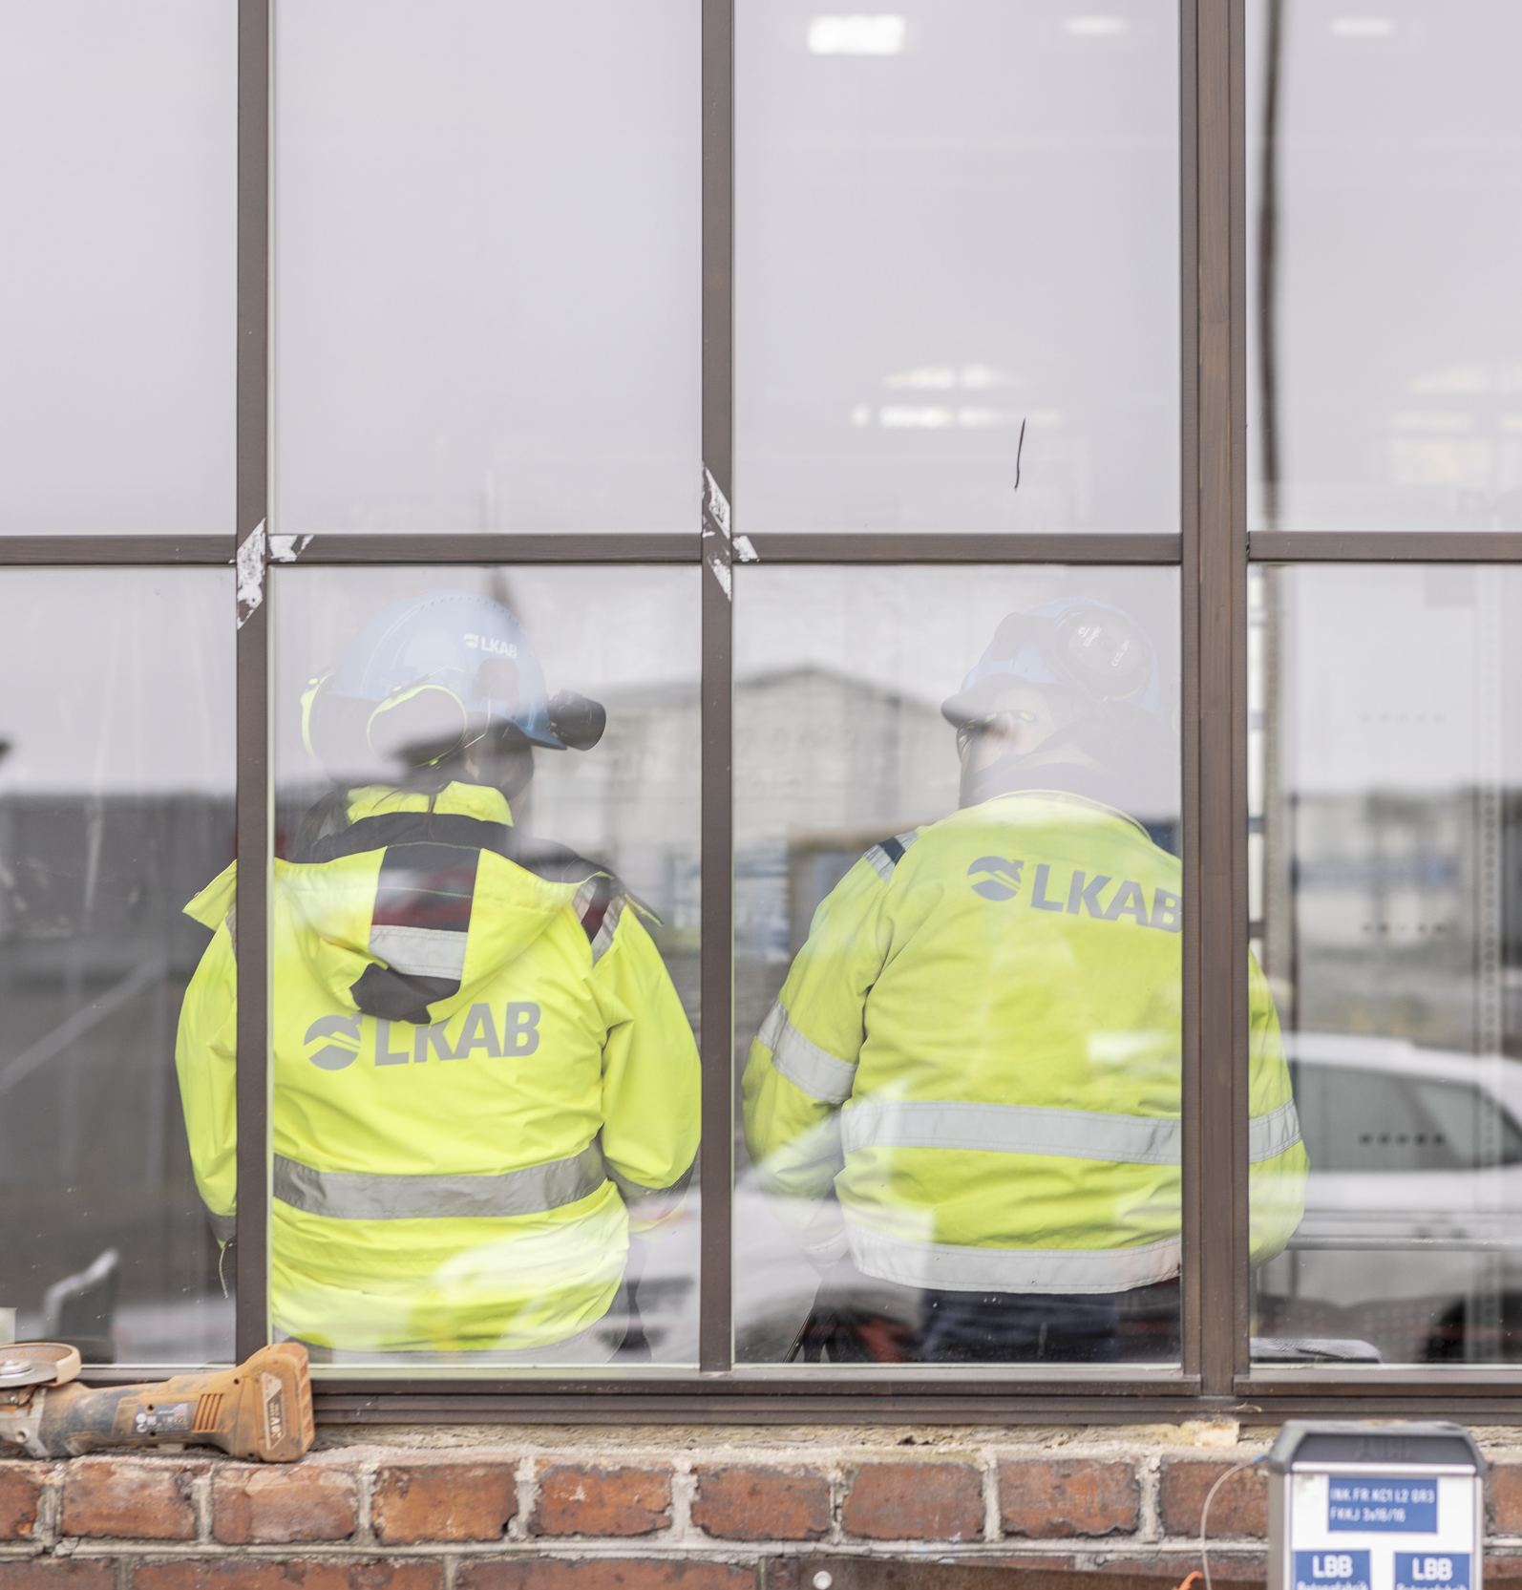
Strategic objectives for Safety First
LKAB has two strategic objectives within work environment and safety:
  TO REDUCE / ELIMINATE:
  Accidents resulting in absence
  Absence due to illness
This assessment was made over a long period, and there are comparable data from our industry and other industries. These objectives are followed up and presented, even externally.

Slide 15
A safe and sound work environment
THE FOUR SUB-AREAS ARE:
Based on current research, LKAB has produced a unique Work Environment Index that summarizes outcomes in the four sub-areas. The index covers both our own personnel and suppliers/contractors working in our operations.
We will focus on four sub-areas, all of which are decisive for developing a safe and healthy workplace (sub-area within parentheses):
Safety (Serious accidents and incidents)
Health (Significant long-term work-related ill health)
Inclusion (Perceived inclusion)
Well-being (General health condition)

Slide 16
A safe and sound work environment
Our work with activities in the four sub-areas is expected to lead to the desired outcomes for the strategic objectives.
Based on current status and needs and at all levels, each operation will implement work environment management to reach the objectives.

Slide 17

Questionnaire survey for sub-areas Inclusion and Well-being
The status of the objectives for the sub-areas Safety and Health is measured via reporting and data from Company Health Services.
We have chosen to follow up progress in the sub-areas Inclusion and well-being by asking you directly, since your perceptions are the most important indicator.
The questionnaire is issued once a year. Take time to answer the questions about inclusion and your perceived health status, so that LKAB can gain a good overview for future prioritisations in the effort to improve conditions for safe and sound workplaces.
It starts with you!

Slide 18
Work environment Index
– meaning, dialogue and reflection
3

Slide 19
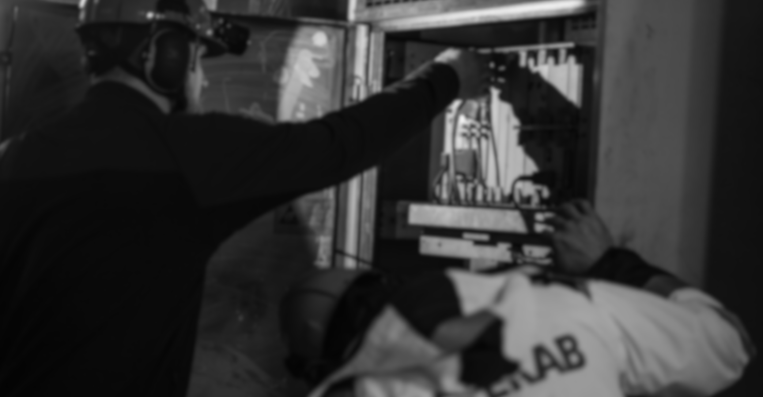
By being committed, innovative and responsible, we will ensure a safe and healthy work environment in all our workplaces.
We will focus on four sub-areas, all of which are decisive for developing a safe and healthy workplace:
Safety
Health
Inclusion
Well-being

Slide 20
Safety
The goal for all of LKAB is to reduce the number of serious accidents and incidents. This means that each of us must work to prioritise the risks that can lead to serious injuries.
Safety First becomes a real challenge for us when things aren't going as they should; but it is then that it is most important. Each of us contributes to safety in our workplaces.
We have to work with well-known risks, plant safety and roles of responsibility. But new risks arise in connection with the transition; e.g., increased mobility among contractors and co-workers, which means that we have to ensure the right expertise and co-operation.
You can help to prevent many serious incidents by:
Following the Golden Rules. Our behaviour creates safe and healthy workplaces.
Emphasise safety improvements via the work environment path.
Suggest activities that improve safety.
Take part in work with LKAB's risk management tools.

Slide 21
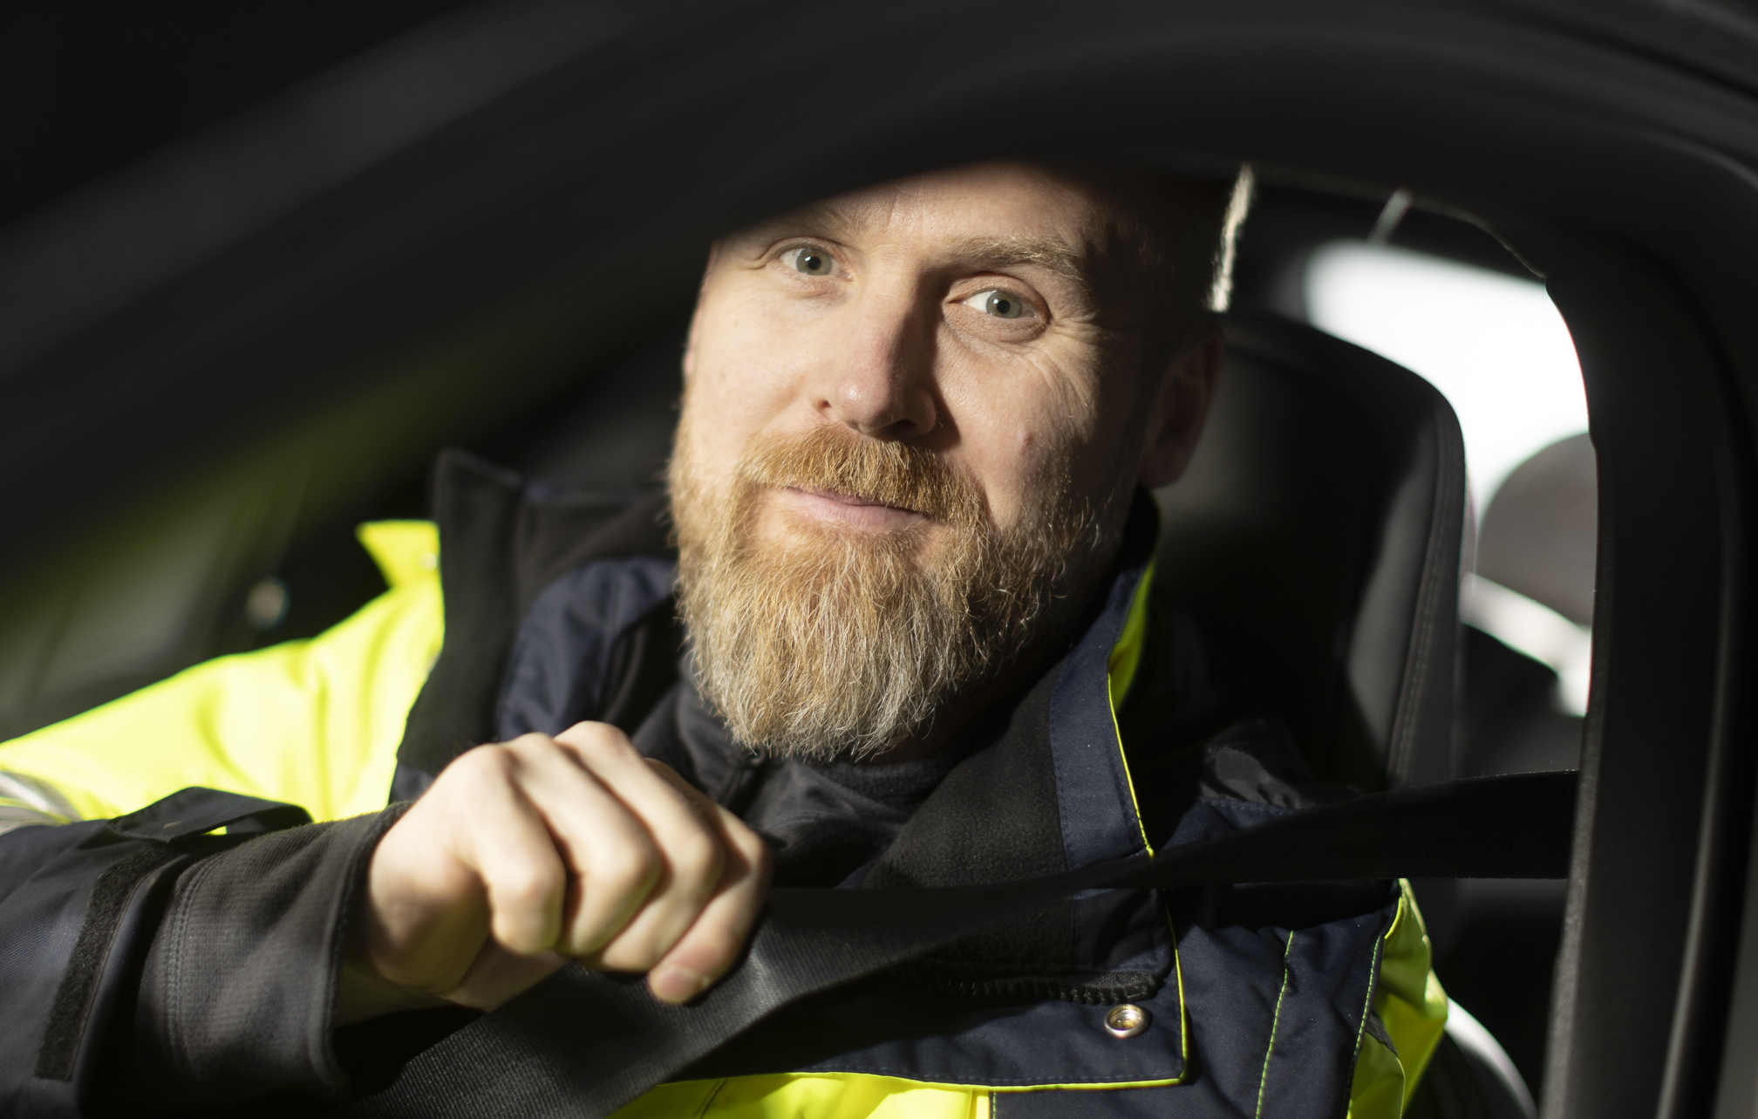
Safety – It starts with me
Exercise
Reflect 5 minutes over what is important about Safety First for you.
What are the most important factors that enable me to do my job safely?
With the person next to you, discuss what is most important for you.
Share 3 examples with the whole group.

Slide 22
!
Health
It's all about feeling as well as possible, based on on your personal situation and prerequisites.
LKAB aims to provide a safe and sound work environment in which risk factors for ill health are eliminated and good health is promoted. In the work environment there are factors that place health at risk and factors that foster good health. These factors interact.
Here, risk management has to do with eliminating hazards to health while at the same time promoting factors that improve health.
How well we succeed in proactively managing risk factors in the work environment is measured via the outcome indicator ’significant long-term work-related ill health’. For example, ill health may be due to ergonomics, or it may be related to workplace-organisational or social factors; this can be quantified by statistics from Company Health Services.
Depending on where you work, you can participate actively in LKAB's health-promotion effort in many different ways. Common for all of us, e.g.:
We follow the Golden Rules. Our behaviour creates safe and healthy workplaces.
We work with risk management
Suggest health-promoting activities

Slide 23
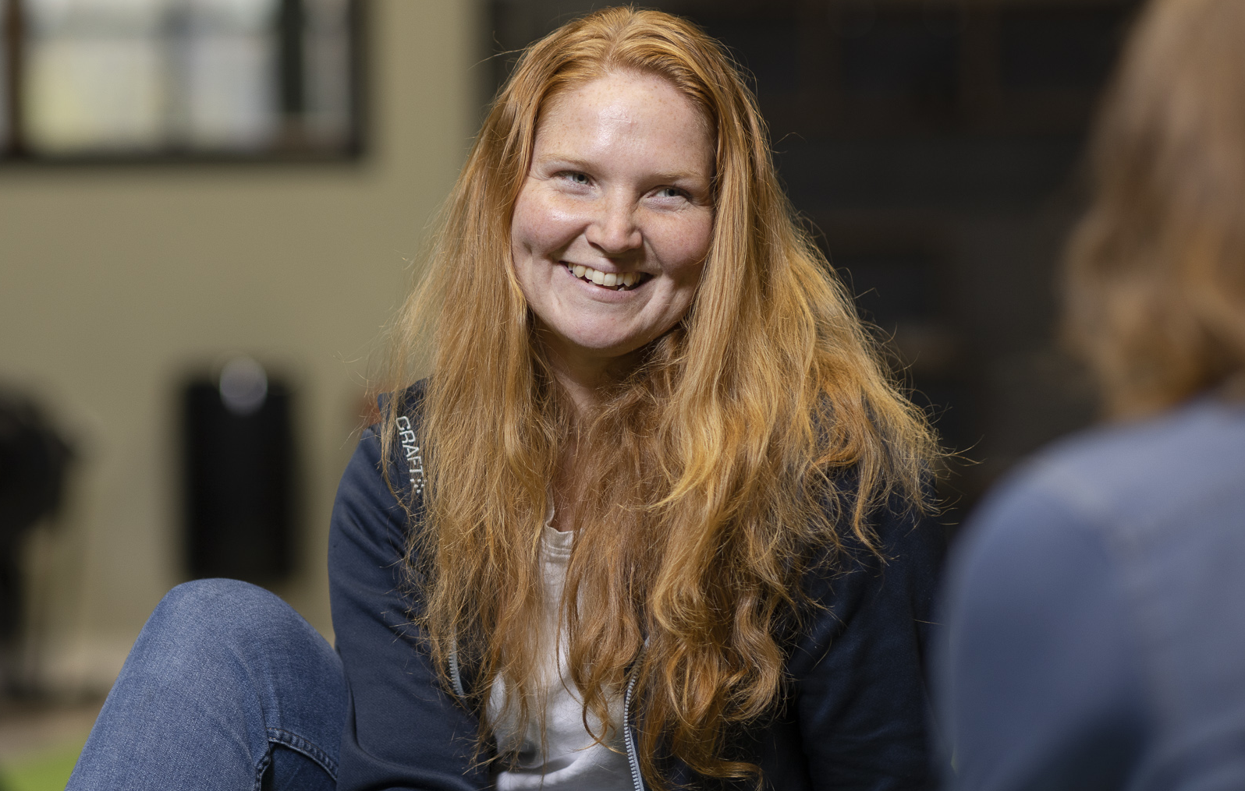
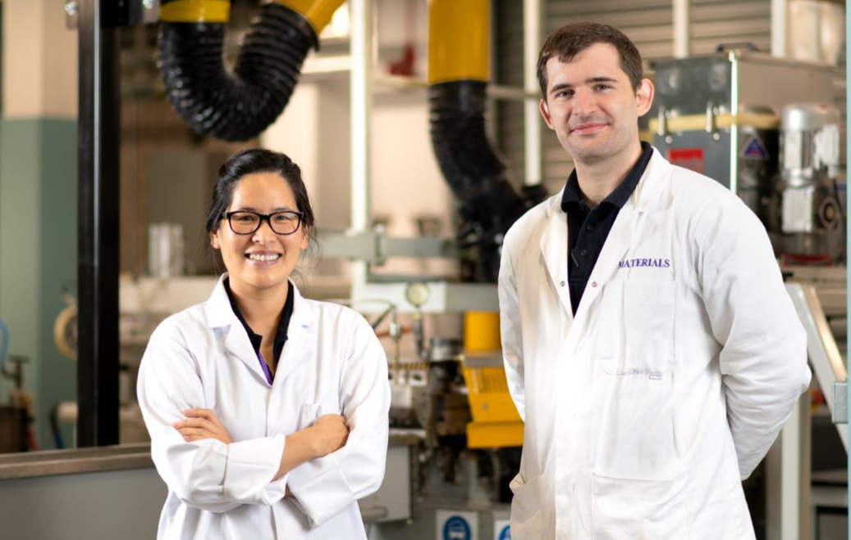
Health – It starts with us
Exercise
Reflect for 5 minutes on what you do to ensure that your health is not directly impacted negatively by your work.
What are the most prevalent health risks (physical and workplace organisational and/or social factors) in our workplace and how can we reduce these risks?
With the person next to you, discuss what you do to feel well at work.

Slide 24
Inclusion
No matter who we are in our free time, we work together for change. Within LKAB, inclusion is a matter of everyone feeling that they belong to a group.
We can actively involve colleagues and contractors in this effort in an appropriate way. The people you meet at LKAB can contribute different perspectives and, together, we can meet our challenges.
You must be able to be yourself at work, be respected and respect others.
What you do in your day-to-day work in your workplace has a big impact. We all need to reflect over how we contribute to inclusion in our workplaces.
Inclusion; it starts with me:
Follow the Golden Rules. Our behaviour fosters inclusion.
Suggest activities that improve inclusion.
In our operational plan we can formulate our work towards increased inclusion together.
Take part in work with LKAB's risk management tools*.

Slide 25
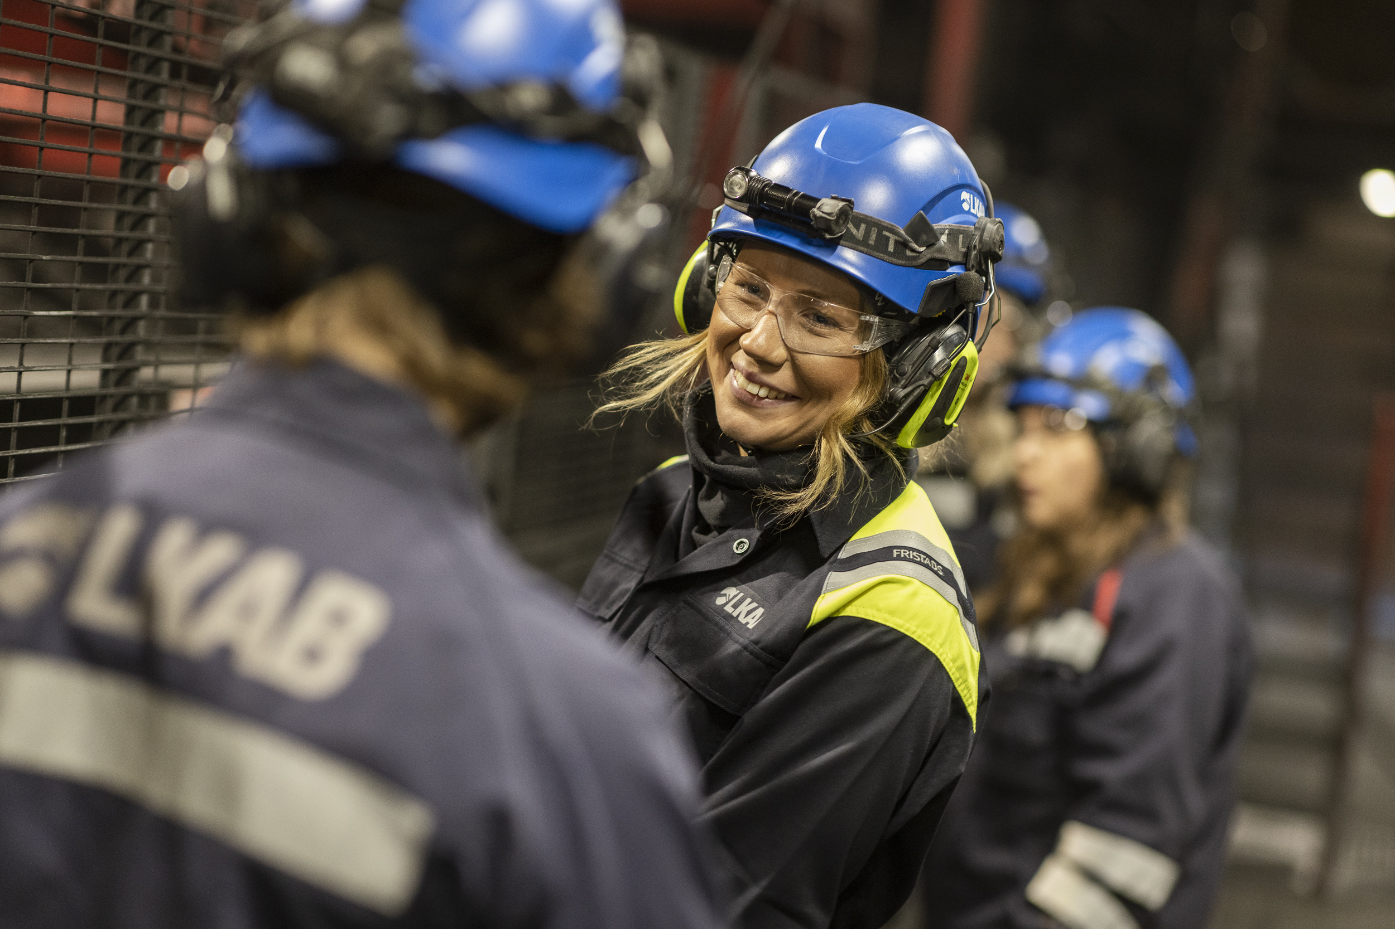
Inclusion – it starts with me
Exercise
Divide into groups of 3-4 people/group. Reflect for about 10 minutes:
For you, what is inclusion?
What do we mean by inclusion in the workplace?
With the person next to you, discuss what you can do to improve inclusion.
Share one example per group with the whole group.

Slide 26
Well-being
LKAB's goal is for co-workers to feel well. Managing health-promoting factors is all about strengthening health. LKAB's focus on improving the work environment within the company centres on health and well-being. Health and well-being are largely about our perceptions of our own health status and how we feel.
Many factors, physical as well as in the organisational and social work environment, together with conditions for a healthy lifestyle, must interact to bring about a feeling of health and well-being in every individual. There is no definitive boundary between working life and private life, since they often overlap and impact each other.
The outcome of how well-being* changes over time is measured annually for the entire group via surveys
Outcome for how well-being* has changed over time is measured annually for the entire LKAB group via questionnaires.
Depending on where you work, you can participate actively in LKAB's health-promotion effort in many different ways. Common for all of us, e.g.:
Follow the Golden Rules. Our behaviour creates safe and healthy workplaces.
Dialogue with your manager about balance of requirements and resources.

Slide 27
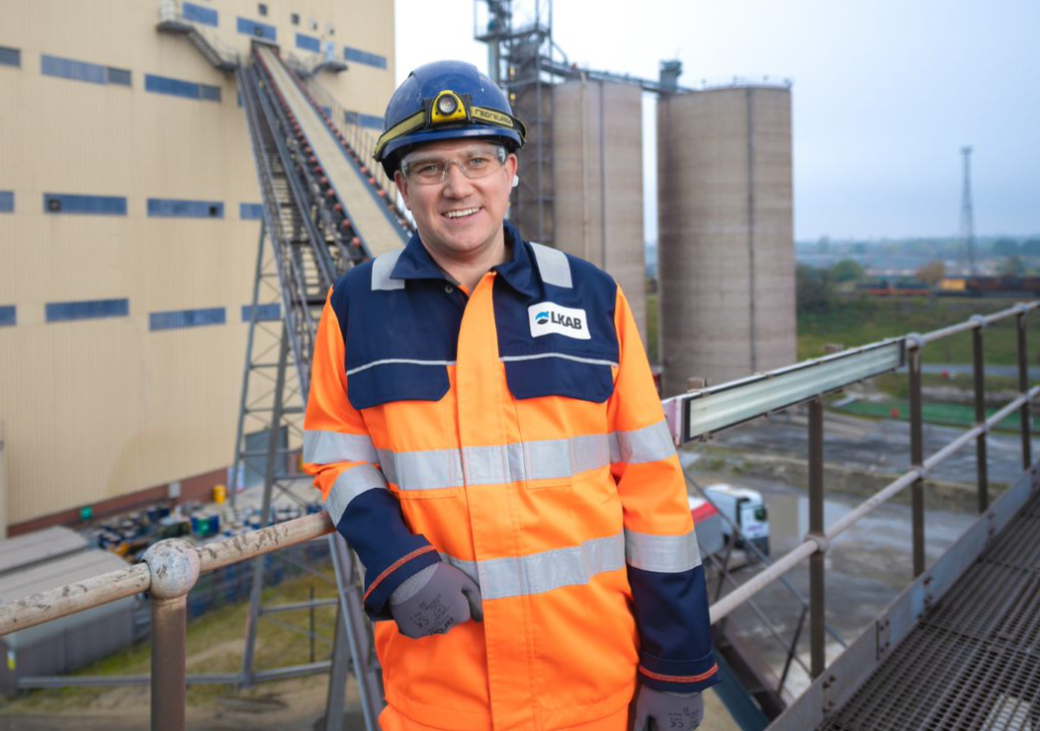
Well-being – it starts with me
Exercise
Reflect for about 5 minutes:
In what way can we help one another in the workplace to create the conditions for feeling well?
With the person next to you, discuss what you can do to improve work satisfaction.

Slide 28
The Golden Rules
4

Slide 29
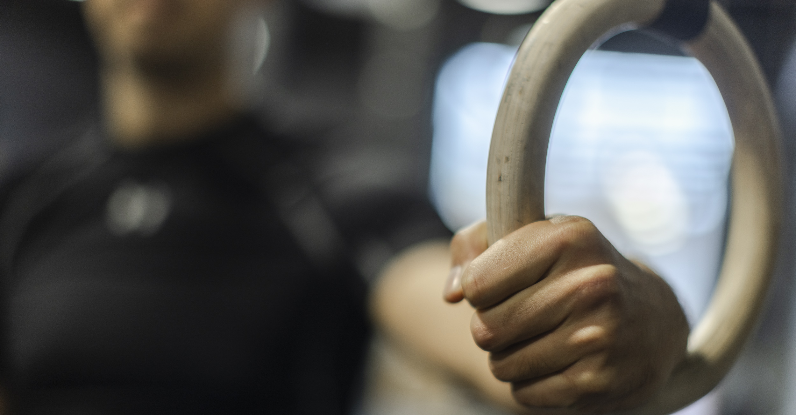
The six Golden Rules
Recognise and praise correct / safe behaviour
Lead by example
Let’s talk
Always challenge acts that could cause harm•
Stop and think– what coudl go wrong?
Never bypass a system designed to prevent harm
It starts with you.
Your behaviour and what you do is what creates a safe and healthy work environment.
As a guide to how we should behave in relation to one another, we have a common approach based on what we call the Golden Rules.

Slide 30
It starts with me –
What is your impetus for Safety First?
"Each of us has a responsibility." As your function... in your workplace... you explain your responsibility and how it relates to Safety First...
The most important golden rule for me is the golden rule... therefore the impetus is..."
Share your slogan with the person next to you.
Complete the pink field to the right and make your own slogan!

Slide 31






Introduction of the Golden Rules throughout the entire group
Background
In 2018 Special Products introduced five golden rules for creating safer, more secure workplaces.
In 2019 ”Let’s Talk" was added. A golden rule that emphasises the importance of talking about difficult issues, values, norms and rules in the workplace – in line with the group's objectives for work environment.
In 2021 the rules were presented to chief safety officers and business area managers.
In 2022 the rules were adopted for all of LKAB upon the decision to introduce the group guideline for Safety First.
RECOGNISE AND PRAISE GOOD BEHAVIOUR
LEAD BY EXAMPLE
LET’S TALK
ALWAYS CHALLENGE ACTS THAT COULD CAUSE HARM
STOP AND THINK
- WHAT COULD GO WRONG?
NEVER BYPASS A SYSTEM DESIGNED
TO PREVENT HARM

Slide 32
Important components of Safety First
This section contains shorter versions of parts of the group guideline.
5

Slide 33
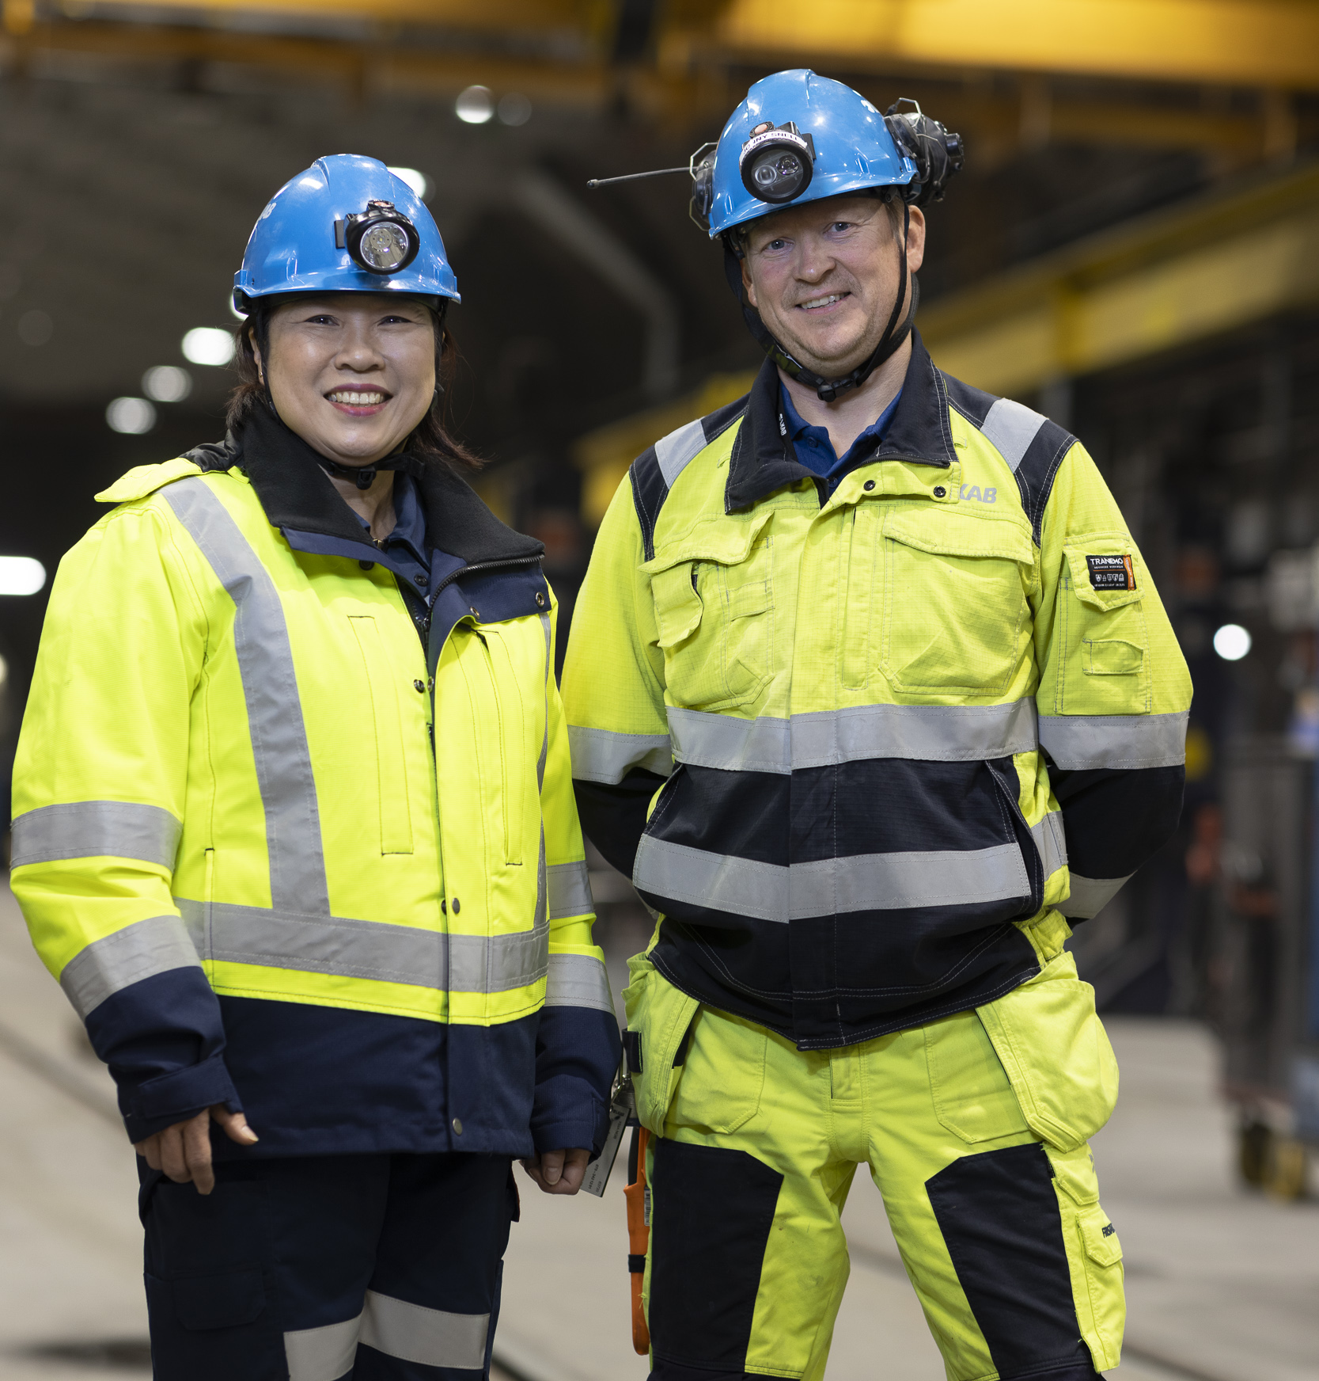
The basis for LKAB's work environment management
Safety First sets the framework for our work environment management and will be developed in line with our strategy.
We all take part in work environment management, depending on our roles and tasks. Together, we have several fundamental tools and methods that are common for all of LKAB and are described in the group guideline. Several examples:
Risk management
Collaboration with contractors
Sanction system for the safety of all
Laws and governance
In this section are some summary points from the group guideline, with which all who work for LKAB must be familiar.
The section contains a few summarized parts of the group guidelines that everyone who works for LKAB should be familiar with.

Slide 34
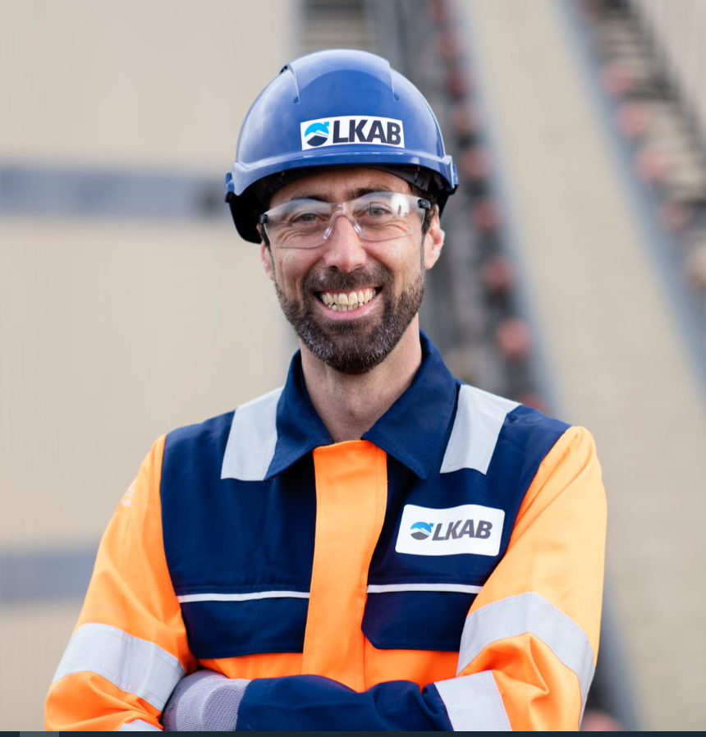
Laws and governance
Together, we will ensure that we comply with laws and rules.
To be able maintain an overview of the status of our work-environment work, we use a common tool for systematic work-environment work called the SAM/SWE checklist.
Issues which we, as individuals, can manage on the basis of on our roles and responsibilities will be resolved as close to the workplace as possible. If this is not possible, "the path of the work environment issue" describes how the issue will be addressed.

Slide 35
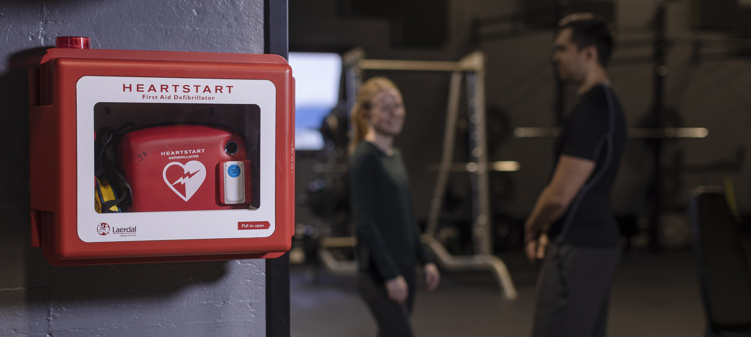
Risk management
To remind you and to help us to manage risks effectively throughout all of LKAB, we have adopted the following common approach to risk management:
Norms and Rules
Risk assessments •
Safety rounds
Consequence assessments in the event of changes in operations
Reporting, investigation and management of risks, incidents, accidents and occupational illnesses
Risk management within LKAB means that, in order to manage risks, we will identify them before they arise.
Risk management has to do with fundamental activities within Safety First.

Slide 36
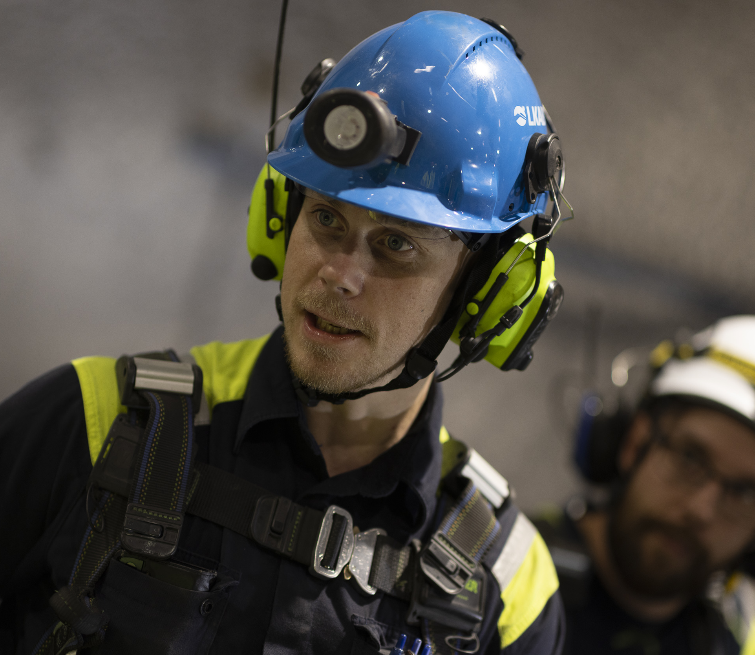
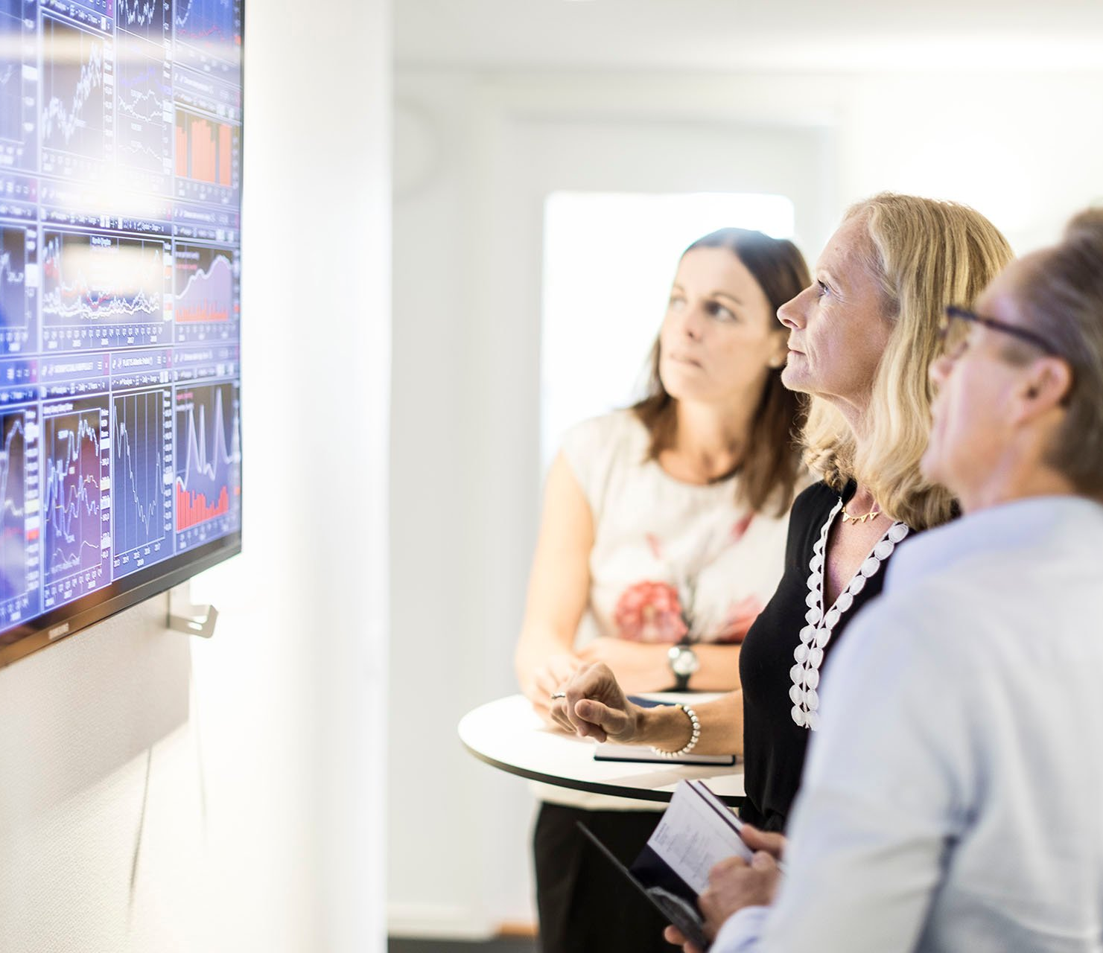
Suppliers and contractors
When we purchase external services we must follow the process for selection, assessment and development of suppliers/contractors.
We will also involve our contractors in our common work-environment management.

Slide 37
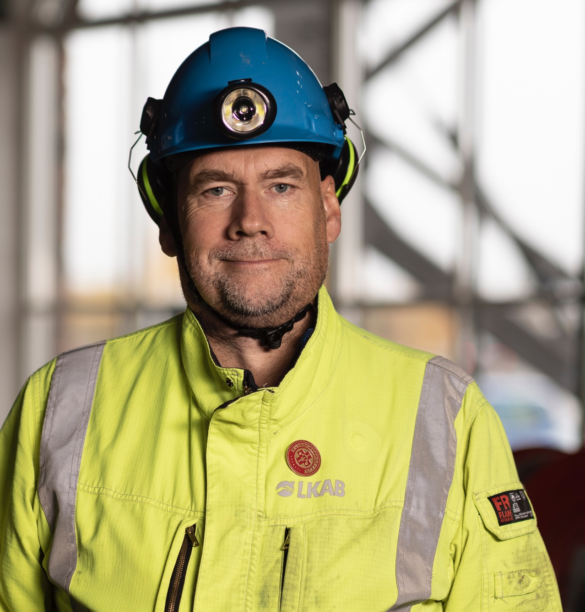
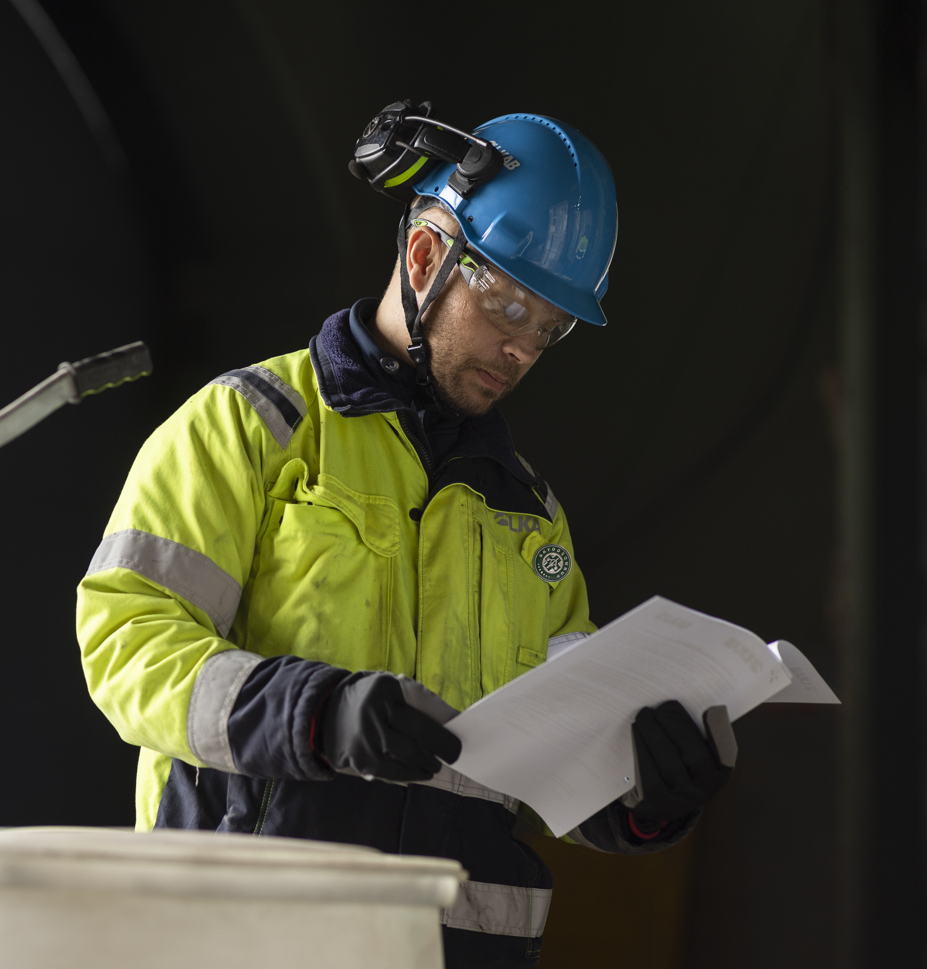
Sanction system for the safety of all
When we observe incidents of repeated negligence in following our work-environment and safety procedures, the consequence will be legal action.
We apply a systematic method to ensure consistent handling of incidents of negligence/non-compliance, for both co-workers and suppliers/contractors.

Slide 38
Conclusion
6

Slide 39

Summing up the day
We want to take this opportunity to share our view of what Safety First means for all of LKAB today and at the same time give you the chance to consider how you can help to take Safety First into the future.
HAVE WE DONE WHAT WE SET OUT TO DO TODAY?
If you would like to read more, you'll find it all here:
Safety first! Joint group governance and objectives

